Slide 1
Microservices and DevOps
Scalable Microservices
The Microservice Architectural Style
Henrik Bærbak Christensen

Slide 2
Designing MS Architectures?
The challenge:
We have the MS definition
  All those benefits (and liabilities)
What’s next then???
How to ‘do it’?
Our Take: A set of central concepts in the architectural design process.
Overlap with SAiP fagpakke ☺

Slide 3
Architectural Style
Similar to architectural pattern and out of fashion, but I do like the different perspective and the conceptual framework it brings along:
Architectural Style:
  Set of element types (components)
  Set of interaction mechanism (connectors)
  Topology of components
  Semantic constraints
Exercise:
  Client-server ?

Slide 4
Relation To Def
Actual the definition is quite precise about a subset of the defining characteristics of the
The Microservice Architectural Style
  Components, Connectors, Topology, Semantic constraints

Slide 5
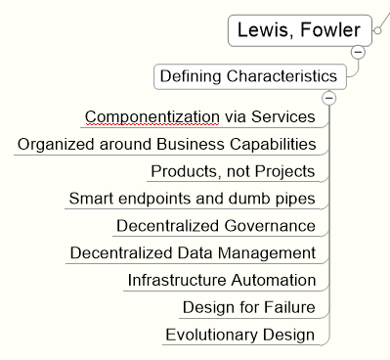
Relation to Def
The Microservice Architectural Style
  Components, Connectors, Topology, Semantic constraints

Slide 6
Aspects

Slide 7
Coupling and Cohesion
So old, and so difficult to get right
‘it is all about role boundaries’

Slide 8
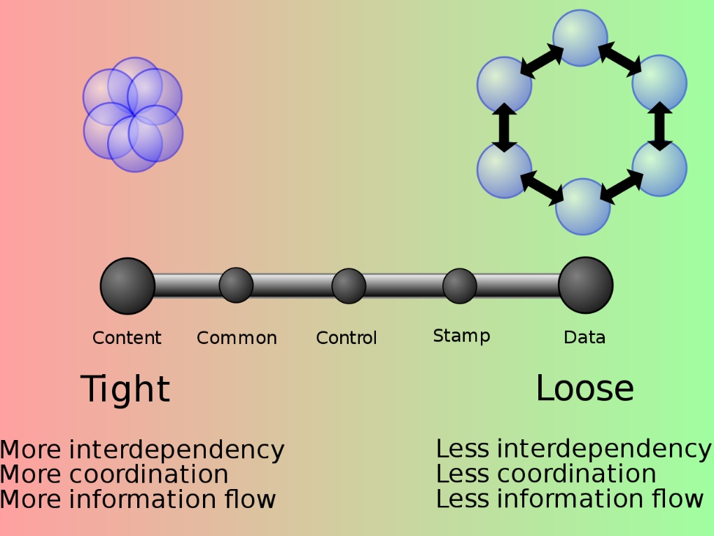
Larry Constantine
Late 1960’ies formulation
  Coupling
The antidote:
  Information Hiding
    David Parnas
  Encapsulation
    An inside and outside
Shaw
  It is not the functionality per se, it is the packing

Slide 9
Packaging
To rephrase the previous software reuse historical treatment, much of every new tech-hype has been about a new scheme for packing software into a deploy unit
  Modules (modula 2) : Language packaging
  Objects (simula/smalltalk) : Language packaging
  CBS: Static deployments
  SOA: Dynamic deployments
  Microservices: Dynamic deployments at scale
Note that packing does not really help on coupling

Slide 10
An OO Experience
My early OO experience usually ended in one of two places
  A mesh of highly interconnected objects ☹
  A god class that starved any other object from behavior ☹
The Mediator Pattern
  Intent: Object that encapuslates how a set of objects interact. Mediator promotes loose coupling by keeping objects from referring to each other explicitly, and lets you vary their interaction independently.
  Head On book: Centralize complex control and data flow between related objects

Slide 11
Visually
Replace high interconnectivity with central Mediator
Liability: Is what???
Notes:
Meditors are often rather complex

Slide 12
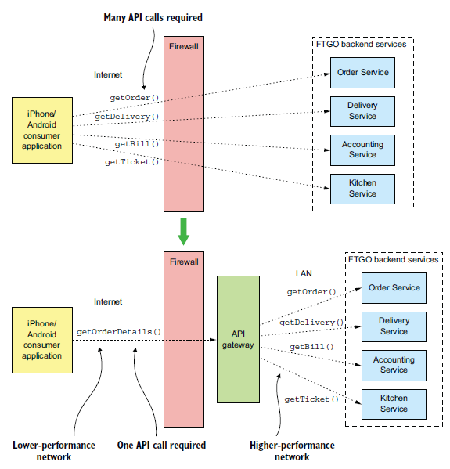
API Gateway pattern
API Gateway patterns is essentially the ‘out-of-process’ equivalent to the Mediator.
SkyCave: Who plays the Mediator role?
But note:
  Smart services, dumb connectors !
Richardson, p 261

Slide 13
Compositional Principles
The old GoF
principles of reusable design

Slide 14
Worth Mentioning
Principle 1:
Program to an interface, not implementation
  Make a clear contract between supplier and consumer
Principle 2:
Favor object composition, over class inheritance
  Make system as composition of services

Slide 15
Bounded Contexts
From Domain Driven Design
(DDD) by Eric Evans…
Newman §3
Notes:
Newman §3 / p 31

Slide 16
Bounded Contexts
Domain = Set of bounded contexts.
  Bounded context = model elements that are private plus model elements that are shared externally with other BCs.
  Bounded context = specific responsibility enforced by explicit boundaries
  Request to BC through shared models on explicit boundary
  Analogy with living cells – membranes define what can pass
Eric Evans: Domain-Driven Design Book

Slide 17
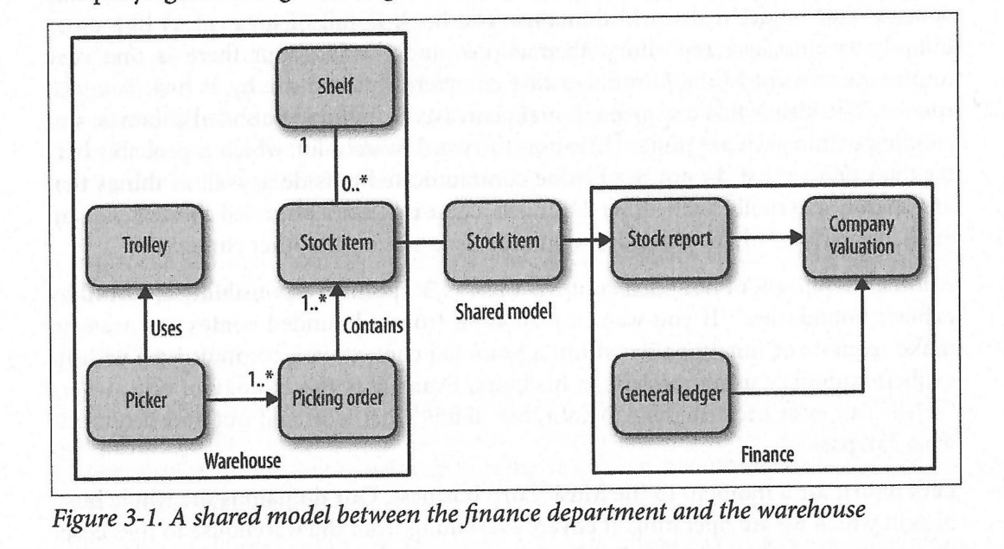
MusicCorp Example
BC: Finance and Warehouse
Shared model: Stock Item
  However: full stock object not relevant for finance
    Shelf location has no meaning to finance, only value and count
  Stock has both an
  internal (hidden)
  and external
  (shared)
  representation

Slide 18
Definition?
Shared Model: A subset of a model, containing only properties relevant for a given, external, bounded context [My take on a definition].
Example:
  A ‘return’
    Customer context: print return label, await refund
    Warehouse context: package that will arrive, restocking
Discussion
  I guess it means there can be several ‘shared models’ for a concept
    Stock Item for Warehouse, Finance, Customer, …

Slide 19
On a more Language Level
One way of exchange models on BC boundary
  HTTP GET that JSON object from the service
  Broker ‘List<PODO> getListOfMessages()’ in ChatRoom object, where client has a ChatRoomClientProxy
  Subscribe to ProtoBuf encoded binary object from RabbitMQ on topic using routing key: ‘*.measurements.aarhus’
Models are PlainOldDataObjects/PODOs.
  Optionally with abstract references ala foreign keys
    For further exchange of ‘models’ that represent these sub PODOs

Slide 20
BC as Modules
Bounded contexts form module (CC view: Component) boundaries
  Module = classic static/compile time software unit, with explicit interface(s), Facade pattern
Excellent candidates for later microservices!
  Monolith first tactic. Avoid premature decomposition
  Why
    API refactorings are extremely slow in the remote case…

Slide 21
Compare OO Perspective
OOA and OOD
  The obvious old OO way:
    StockItem Warehouse::getAllItems()
Liabilities
  Expose internal
  warehouse details
  Hard binding through
  object reference(s)

Slide 22
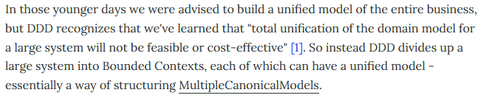
Compare OO Perspective
Fowler ‘BoundedContext’ paper
WarStory: EPJ domain…
  GEPJ
  HL7 and CDA

Slide 23
Business Capabilities
Fowler: Organized around business capabilities
Bounded contexts provide services to each other
  Warehouse: get stock list
  Finance: set up payroll for new employee
Shared models contain the information exchanged
Hidden models (= internal/full models) candidates for the data management layer

Slide 24
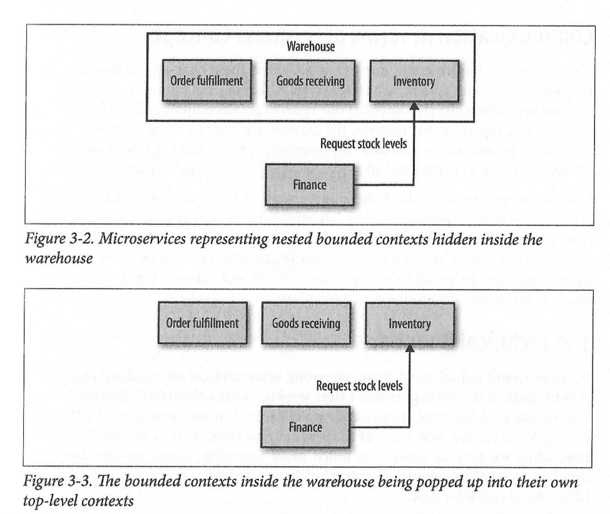
Decomposition
BCs can be a composition of sub BCs
  Heard it before ☺?
Consider org. Boundaries
  If different teams/groups
  it may make more sense
  to go for decomposition
  Conway’s law…
Consider testing
  Nested appr. means less
  test doubles…
Notes:
Testing: In 3-3 you have to make test doubles for three services while in 3-2 you only have to make a single test double.

Slide 25
Domains are Stable
One of the first rules of OO design I learned:
  “Domains are more stable than user requests to UI and functionality”
  OO modeling was highly ‘domain modeling’
    OOA
DDD and BC are founded in the same ‘truth’
  Business changes more likely to be isolated to a single BC
I do not completely agree…

Slide 26
Roles and Responsibilities
Loosening the Boundaries from the Domain

Slide 27
Much Bounded Context Hype
Every Microservice book I look into has chapters on DDD and Bounded Contexts.
Which is rooted in the domain model!
I am old enough to have seen that before:
Object Oriented Analysis and Design
  Talk to customers and write down the nouns. These are the classes. Then write down the verbs that are associated with these nouns. These are the methods.
Experience then showed that it was a lot of bullsh…

Slide 28
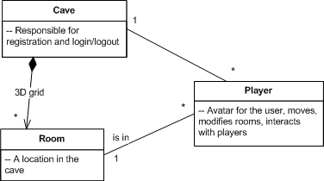
Domain is not All
Domain classes are important but there are so much more to complex software systems than domain concepts.
Example:
  2016 SkyCave consists of 97 classes. Only three of them are domain classes!
  Rest is about:
    Distribution
    Persistence
    Variability Management
    Dependency injection
    QA, like availability, performance, …

Slide 29
Domain is not All !
Large classes of important software designs cannot be explained from a purely Domain focus!
Example: Design Patterns
  Strategy pattern:
    Encapsulate algorithm and let it vary independently of consumer
Absolutely no counterpart in any domain
  And still a central software architectural tool in the architect’s toolbox

Slide 30
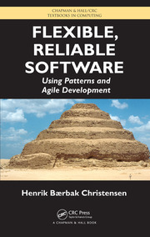
Stronger Conceptual Framework
Roles, Responsibilities, Behavior,
and Protocol
Not
  The Order Concept
But
  The responsibilities associated with
  handling an Order
Leads to more fine-grained
abstractions
More ‘-able’ than noun interfaces

Slide 31
The Central definitions
The central concepts:
  Behaviour: What actually is being done
    ”Henrik sits Sunday morning and writes these slides”
  Responsibility: Being accountable for answering request
    ”Henrik is responsible for teaching responsibility-centric design”
  Role: A function/part performed in particular process
    ”Henrik is the course teacher”
  Protocol: Convention detailing the expected sequence of interactions by a set of roles
    ”Teacher: ‘Welcome’ => Students: stops talking and starts listening”

Slide 32
I see the Trend Already
FaaS: Function as a Service
  A Responsibility that is set free from its prison in a bounded context, or a domain concept.
The Strategy Pattern in a new Packaging!
Roles are often invented independent of domain, as just a cohesive collections of responsibilities
  Kindergarten example: The Flyer role…
  Car example: Is it an umbrella? Is it umbrella behavior?
  (anyone read Larman? ‘Pure Fabrication’ principle)

Slide 33
So…
Bounded Contexts and DDD are fine starting points
  Just as domain understanding was it in OOA and OOD
But do not let it restrict you
Think
  Roles = responsible for cohesive part in particular process (or responsible for a service to the community!)
Microservices should perform roles, and use a protocol to exchange control and data (shared models)

Slide 34
DRY or Not DRY
Do not Repeat Yourself
Or maybe you should ☺ !

Slide 35
DRY
Step five of the TDD rhythm
  Step 5: Refactor to remove duplication
Duplicated code is root of all evil
  Dual maintenance, fixing a bug once-and-for-all is very difficult, etc. etc. etc.
Then what about the shared models? And connector implementations/client libraries

Slide 36
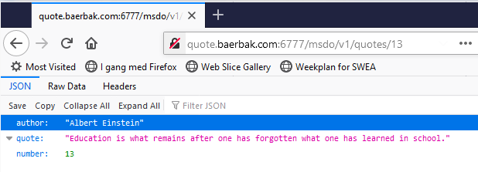
SkyCave Example
The battle-hardened quote service
Why not have a shared library with the quote PODO?
  Class quotePodo { String author; String quote; int index; int statuscode; }

Slide 37
DRY downside
You create hard bindings in the form of shared library dependencies
  Both producer and consumer depend upon quote-lib:1.7.3
  May create ‘lock-step’ versioning
    Library update propagages across all services
  AntiPattern: The Distributed Monolith
  Begins to dictate the programming language ☺
    Cannot import maven libs in python, to my knowledge
Bottomline: Relaxed about DRY across service boundaries
  Programming level: Do not put the ‘shared models’ in shared libs !

Slide 38
Connectors
What about library implementations of connectors?
  Aka ‘client libraries’?
Example: Our ‘RealQuoteService’ implementation – why did I not just hand it out to you?
  (Would be an easy exercise, then ☺)
Newman
  Risk of server logic creeping into the connector logic
Example of ‘it works’
  Amazon Web Service SDK
    Client lib for the AWS REST api
  But developed by other team + community, not the AWS team !!!

Slide 39
Monolith First Pattern

Slide 40
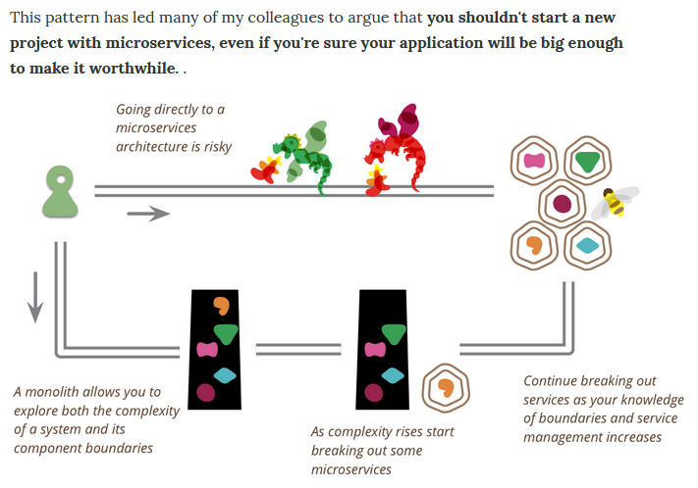
Fowler

Slide 41
My Opinion
Right, I agree totally
  Tool support so much better for in-process communication
  YAGNI principle (you ain’t gonna need it)
But, still
  As service boundaries starts to materialize, I think it makes sense to start to apply the architectural style along the boundary, alas
    Order order = coffeeshop.createOrder(Type.Latte, …);
    May become something like (REST’ifying the communication)
    OrderModel orderModel = new OrderModel(Type.Latte, …);
    OrderResult result = coffeeshop.serviceCall(ORDER, orderModel);
    Order order = result.getOrder();
  That is, ‘Order’ without any deep references. Only a PODO!

Slide 42
My Opinion
Objection to this opinion
  You have no transparency, why not encapsulate the concrete connector style? This code smells RESTish, right?
It is a really good objection, but…
From an architectural standpoint it is highly important to be explicit when a connector is out-of-process
  Nygard: Integration point
    Must be analyzed in terms of availability, performance, security, …
I have to code time-outs, circuit breakers, chunky interface, …, for these connectors! No transparency anyway!

Slide 43
Outlook

Slide 44
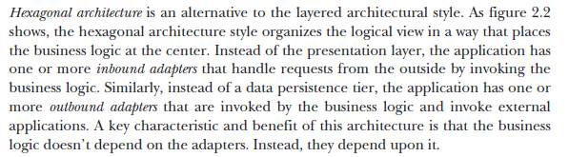
Hexagonal Architectures
Alternative to layered style
Notes:
Richardsen p 38

Slide 45
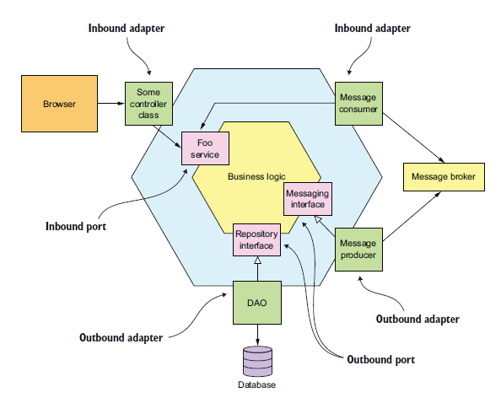
Visually
Benefits
  BL independent of
  presentation and
  data access
  Easier testing /
  decoupling
  Often need for many
  e.g. UI adapters (web,
  mobile app, legacy, ..)
  anyway

Slide 46
So…
What has that to do with microservice architectures?
Nothing, excepts as another way of structuring the kind of applications that most often are candiates for micro service architectures ☺

Slide 47
Pattern Languages

Slide 48
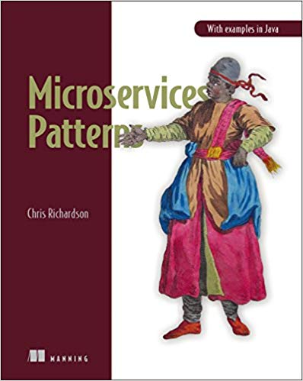
Recommendable Book

Slide 49
Recent Analysis
By Peter Daugaard Rasmussen

Slide 50
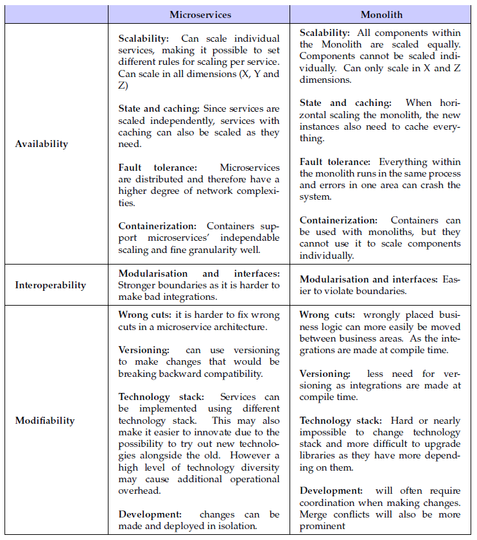

Slide 51
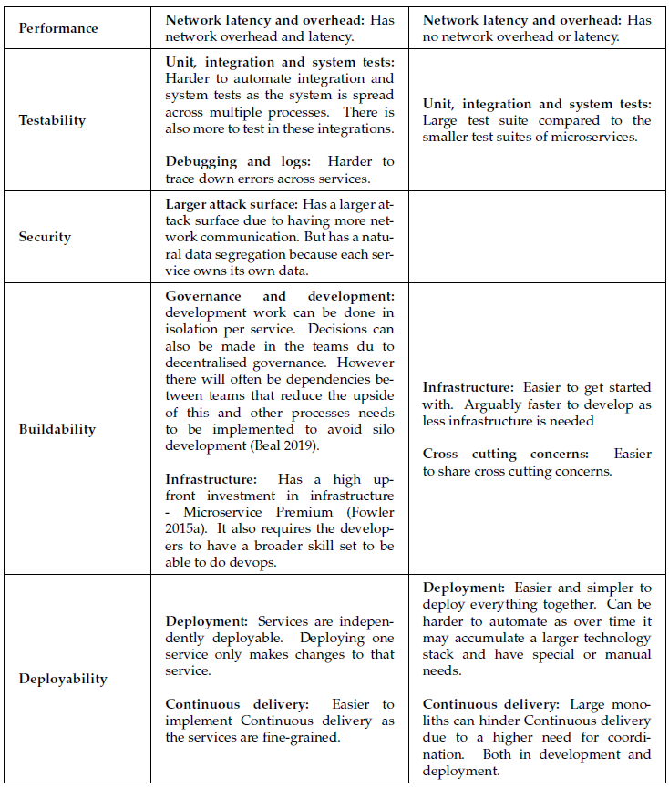

Slide 52
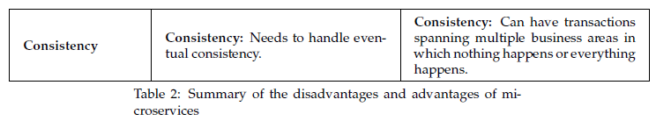

Slide 53
Summary

Slide 54

Software Architecture…
… is difficult !
One definition
  (forgot the author, and is probably misquoting)
  The things we wished we had done differently ☺
IMO it is about ‘cutting the cake in the right way’
  Part the ‘whole’ into ‘suitable’ pieces that collaborate
  Usually, no ‘right way’ just ‘less bad ways’ to pick from…

